Slide 1
CHARACTERISTICS OF GLYPHOSATE ADSORPTION ON INCEPTISOLS AMELIORATED WITH BIOCHAR FROM YOUNG COCONUT WASTE
Herviyanti^{1*},
Amsar Maulana², Teguh Budi Prasetyo¹, Arestha Leo Lita³ and Mimien Harianti¹.
¹Department of Soil Science, Agriculture Faculty, Andalas University, Limau Manis, Padang City, 25164, Indonesia ²Doctoral Student of Agricultural Science, Postgraduate of Andalas University, Limau Manis, Padang City, 25164, Indonesia
³Master Student of Soil Science, Postgraduate of Andalas University, Limau Manis, Padang City, 25164, Indonesia

Slide 2
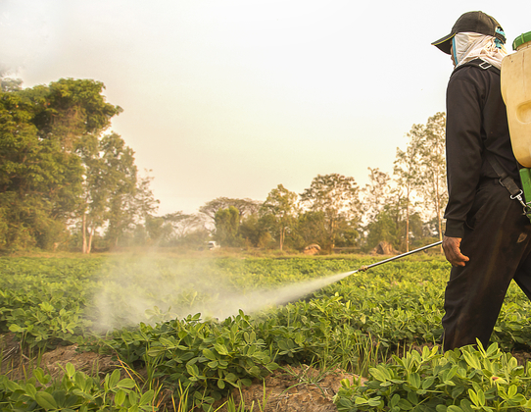
Introduction
Unsustainable environmental management will immediately affect the quality of the ecosystem (agricultural land).
Understanding of the right amount, timing, and method of application of Pesticides.
The fundamental issue is pesticide residues, especially the active component Glyphosate [N-(phosphonomethyl)glycine] or isopropylamine salt.
The annual global usage of glyphosate is estimated to be 600-750 thousand tons, with a projected increase to 740-920 thousand tons by 2025 (Maggi et al., 2020)
Adsorption technology that will be applied to soil to improve soil quality in adsorption of glyphosate with materials for ameliorants such as biochar.

Slide 3
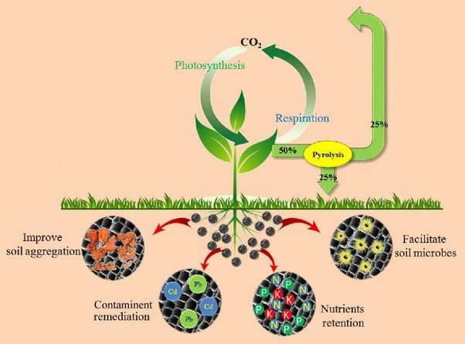
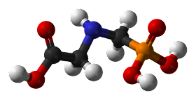
Biochar is prepared by pyrolysis of waste or biomass in the absence or presence of oxygen, resulting in a carbon-rich charcoal composition (Shaaban et al., 2013)
The physicochemical properties of biochar are largely determined by the type of raw material, which is further modified by parameters such as technique (Herviyanti et al., 2022; Maulana et al., 2022), particles (Lita et al., 2022), temperature (Trigo et al., 2016), and others during the pyrolysis process
Inceptisols also have a clay content of 14% and a moderate concentration of organic matter (Pujiati, 2018).
Inceptisols
This study was to determine the ability of inceptisols ameliorated with young coconut waste biochar to do glyphosate absorption.

Slide 4
Material and Methods
Inceptisols from sariak, sungai pua, agam regency in west sumatra, indonesia (-0⁰21’56’’ LS and 100⁰24’0’’ BT)
Soil analysis : clay content, ph-h₂o (active ph) and ph-kcl (potential ph), electrical conductivity (EC), cation exchange capacity (CEC), mineral, soil organic matter (SOM). The FTIR reflectance spectrum was collected between 500 and 4000 cm⁻¹ (Soil Research Center. 2012; Singh et al., 2017).
The glyphosate solution was prepared with 5 concentration levels (0, 1, 5, 10, 50, 100 mg l⁻¹) (Zhelezova, 2017). It was prepared by dissolving the herbicide (roundup biosorb 486 SL) in 0.01 M cacl₂, the concentration of 100 mg L⁻¹ glyphosate was obtained by adding 0.14 ml of herbicide (roundup biosorb 486 SL) in 500 ml of 0.01 M cacl₂. Meanwhile, concentrations of 1, 5, 10, and 50 mg L⁻¹ glyphosate was made from the volume of each concentration of 3.5 ml; 17.5 ml; 35 ml, and 175 ml in 500 ml 0.01 M cacl₂ (Robert, 1981).
The adsorption capacity (q_{e}) : q_{e} = $\frac{(C_{o}−C_{e})}{m}∗V$ (1)
The adsorption isotherm freundlich : log q_{e} = log k_{f} + n log c_{e} (2)
and langmuir : $\frac{1}{Q_{e}}$ = $\frac{1}{{KlQ}_{m}} \frac{1}{C_{e}}+\frac{1}{Q_{m}}$ (3)

Slide 5
Result and Discussion
Clay is the main component of the soil surface charge on clay minerals [15]
This indicates that the increase in surface charge activity and also the positive value of ΔpH indicates that the soil is dominated by negative charges. Positive or negative ΔpH values indicate the presence of positive or negative net charges in colloids, respectively [16].
According to Mindari et al., [17] complexation of H⁺ and OH⁻ on the surface of soil particles can affect the absorption of other cations and anions.
According to Aydin et al., [18] the increase in EC in the soil is initiated by biochar which carries a negative charge so that it can move in an external electric field with an increase in single-charged ions causing an electric field.

Slide 6
3670–3630 and 3600–3200 (v O-H from sorbed water and hydrogen-bonded biochar –OH groups); 1650–1610 and 1610–1580 (H-O-H bending band of water v₂ mode and C=C, alkene group); 1140–1000 (v (Si-O) from clay minerals associated with biochar and minerals) [10].

Slide 7
Glyphosate is an amphoteric small molecule with three polar functional groups.
These are the linearly organized phosphonomethyl, amine, and carboxymethyl groups.
Glyphosate is an ionic compound (log KOW = 3.20), strongly polar, and soluble in water (10.5 g L⁻¹ at 20⁰C) due to the presence of those groups in its structure.
Glyphosate is a polyprotic acid having four pKa values: 0.7, 2.2, 5.9, and 10.6, 8 indicating that the molecule's speciation is affected by the pH of the solution.
AMPA has three pKa values: 0.9, 5.6, and 10.2. Monovalent and divalent anions are the most abundant species in soils [19-20].
The development of a surface complex via the three phosphonate groups and the coordination of OH, O, NH, and P with the adsorbent surface might occur during the adsorption process [21].
Biochar can enhance pH, CEC, and SOM due to an increase in negative charge given by the phenol and carboxyl groups and biochar's high carbon content (22-52%) [23.24.25].

Slide 8
According to Kumari et al., [26] the high frequency of soil + biochar interactions at higher levels of biochar application, including absorption sites in clay and amorphous oxides, plays an essential role in biochar + soil interactions in the glyphosate adsorption process.
The isotherm model that is suitable for the adsorption process is selected on a model that has an R² value close to one [27].
The higher the coefficient of determination (R²) means the better the prediction model of the proposed research model.
The Langmuir model depicts soil and glyphosate forming a single layer in the adsorption process. All sites are the same, the soil surface is homogeneous, and the heat of adsorption does not depend on the closure of the surface active sites [28].
The Freundlich model explains that the heterogeneous soil surface forms a multilayer between glyphosate molecules and the soil surface.

Slide 9
Application of 40 t ha⁻¹ of biochar from young coconut waste on Inceptisols can increase soil organic matter (SOM) by 9.93%, which affects the increase in negative charge (ΔpH), pH, and CEC to 1.40; 0.96 and 24.86 cmol kg⁻¹ which increased their adsorption capacity to glyphosate by 0.87 mg g⁻¹ or 870.27 mg Kg⁻¹ at a pH of 5.07 and a concentration of 100 mg L⁻¹ glyphosate.
The best glyphosate isotherm adsorption occurred at Inceptisols + 40 t ha⁻¹ of biochar from young coconut waste following the Langmuir (R² = 0.9889) and Freundlich (R² = 0.9739) models, where the value of Q_{m} was 19.12 mg Kg⁻¹ and KL was 0.15 L mg⁻¹ while the value of n was of 0.47 and K_{F} of 2.54.
This illustrates the ability of Inceptisols ameliorated with young coconut waste biochar on the monolayer glyphosate adsorption process.
Conclusion

Slide 10
Acknowledgments
We were thankful for the financing of this research. which was provided by PNBP Andalas University (RD Batch 1) under Research Contract No: T/10/UN.16.17/PT.01.03-Pangan-RD/2022 – April 11th. 2022.
Thanks You

