Slide 1
Assessing Speaking in the Online Platform
Handoko, S.S, M.Hum

Slide 2
Smile is Universal Welcome
Handoko, S.S, M.Hum
Sungai Penuh, 11 Oktober 1986
Lecturer at English Department, Faculty of Humanities, Universitas Andalas, Indonesia.
Head of Multimedia Department at ICT Universitas Andalas
Managing Editor of Jurnal Arbitrer
Mendeley Advisor, DOAJ Associate Editor, Figshare Ambassador
Penulis
Get Started

Slide 3
Education 1.0
Education 2.0
Education 3.0
Learners
Apprentice
Client
Co-developers
Learning
Received
Formal and informal
Lifelong
Knowledge
Transmitted
Socially constructed
Open free
Education Evolution
Academics
Expert
Facilitator
Learning Designer
Teaching
Teacher to student
Peer encouragement
Co-construct
Graduate-ness
Degree qualified
License
Multiple careers
Technology
Fixed
Cautiously applied
Digital mobile
Learning Location
Static
Blended, flexible
Everywhere
Still many here!
We are here!
Some have started

Slide 4
Internet Based Learning
eLearning
Blended learning
MOOC
Portion of Content Delivered Online | Type of Course | Description
0% | Traditional | Course with no online technology used, content is delivered in writing of orally
1 to 29% | Web Facilitated | Course which uses web-based technology to facilitate what is essentially a face-to-face course. Uses a course management system or web pages to post the syllabus and assignments
30 -79% | Blended/Hybrid | Course that blends online and face-to-face delivery.
80+% | Online | Most or all of the content is delivered online

Slide 5
Preparation (Physical & Psychological)
Curriculum Design
Instructional Design
Content Creation
Content Delivery
How it’s work

Slide 6
Curriculum Design/adjustment
Step One
Step 2 Two
Step Three
Step 4 Four
Identifying course goals and learning objective
Determine assessments for each objective
Plan learning activities
Determine sequence and space for activities
Before starting designing the learning material, it is very important to design and adjust the curriculum to support the online learning

Slide 7
Instructional Design
Instructional design is the creation of learning experiences and materials in a manner that results in the acquisition and application of knowledge and skills.
Learning Experience
Learning Environment

Slide 9
Goal 1
Objective 1.1
Objective 1.2
Goal 2
Objective 2.1
Objective 2.2
Asessment(s)
Learning Activities
Assessment(s)
Learning Activities
Assessment(s)
Learning Activities
Assessment(s)
Learning Activities
Design a Curriculum

Slide 10
Component of Learning
Learning Material
Learning Activities
Assessment and Evaluation

Slide 11
Synchronous and Asynchronous Learning
Synchronous
Learning that involves a group of students engaging in learning at the same time
Asynchronous
A student-centered learning method using online resource to facilitate information outside the constrains of time and place
Definition
Conducting instant messaging, live chat, video conference
Interacting with learning management system, using forum, video, audio, article, etc
Activities

Slide 12
Assessing Speaking
Pronunciation
Vocabulary
Grammar
Task Fulfilment
Fluency

Slide 13
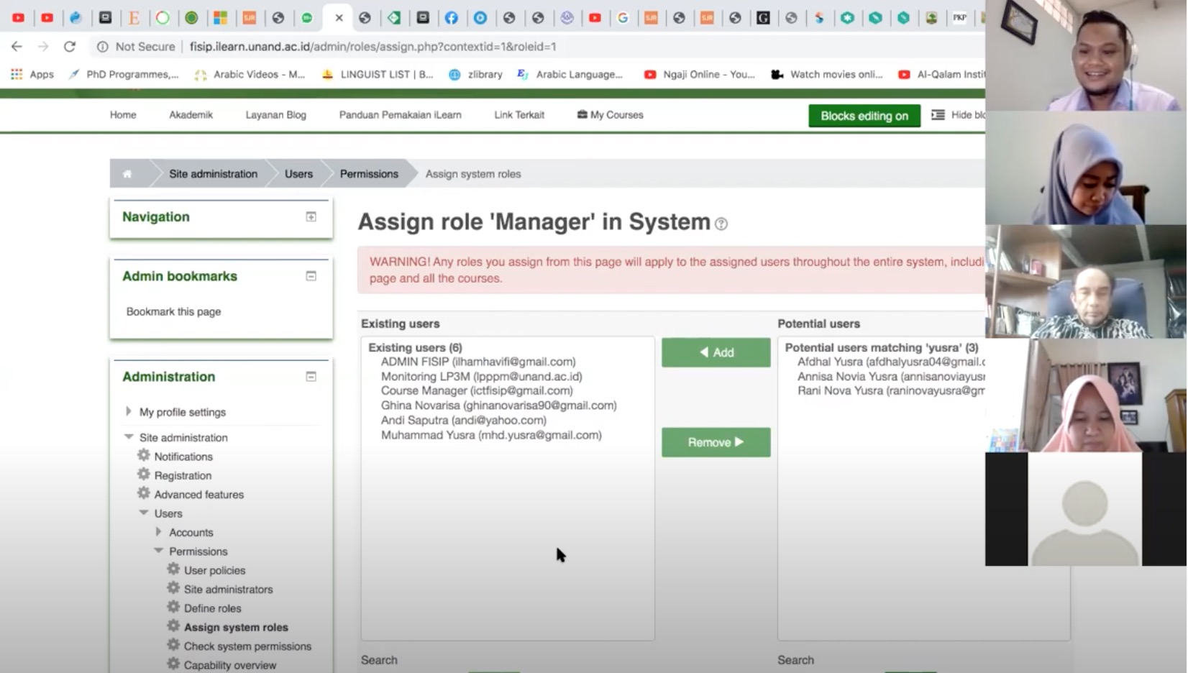
Assessing Via Video Conference (Synchronous)
Advantages
Direct communication
Interactive (two way communication)
Disadvantages
Require good internet connection
Time-consumed
Technical issues (sounds, video, audio noise)
Quite difficult for intense analysis, video can not be re-play

Slide 14
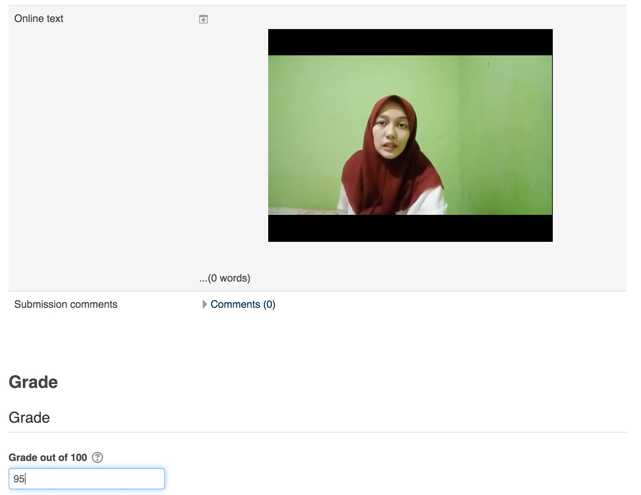
Assessing Online Video (Asynchronous)
Advantages
Do not rely on internet connection
Flexible, efficient
Video and audio more clear
Intense analysis, video can be replayed
Disadvantages
Indirect communication,
Students may read the text

Slide 15
Which one is the best?
It is not which one is the best, but which one suite to your assessment
Different approach (synchronous/asynchronous) can be used for different skills.
This is what we call effective assessment: using a proper approach to assess specific skills
Example:
Synchronous can be more effective to assess fluency, because you can evaluate the direct response
Asynchronous can be more effective to assess pronunciation and grammar because you can replay the video and do deep analysis

Slide 16
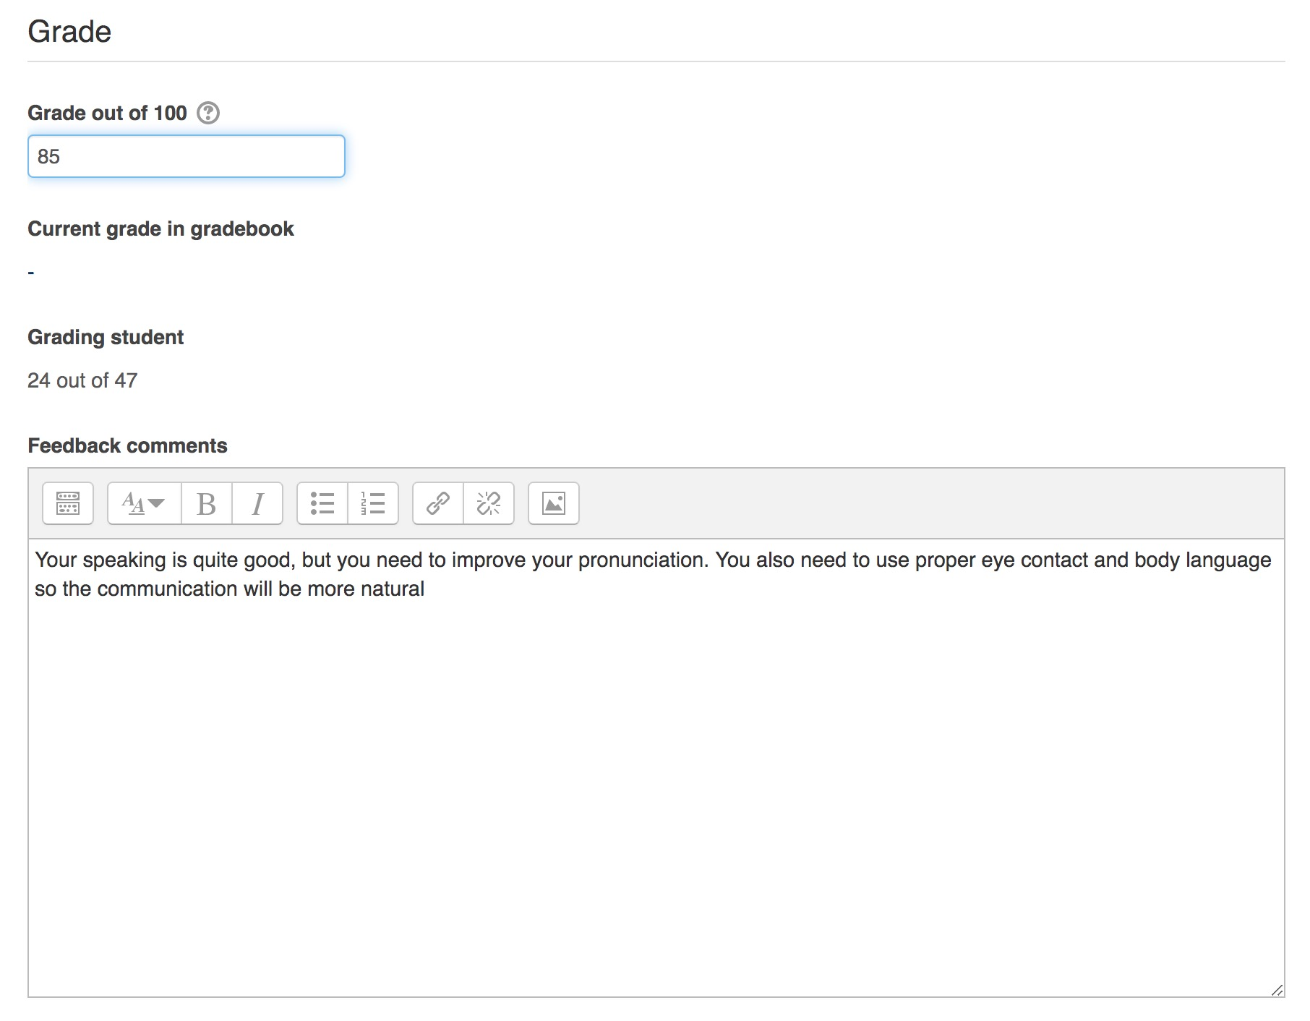
Direct Grading
Advantages
Simple and fast
Disadvantages
No competence described
Inconsistence grading
Writing feedback will be more challenging

Slide 17
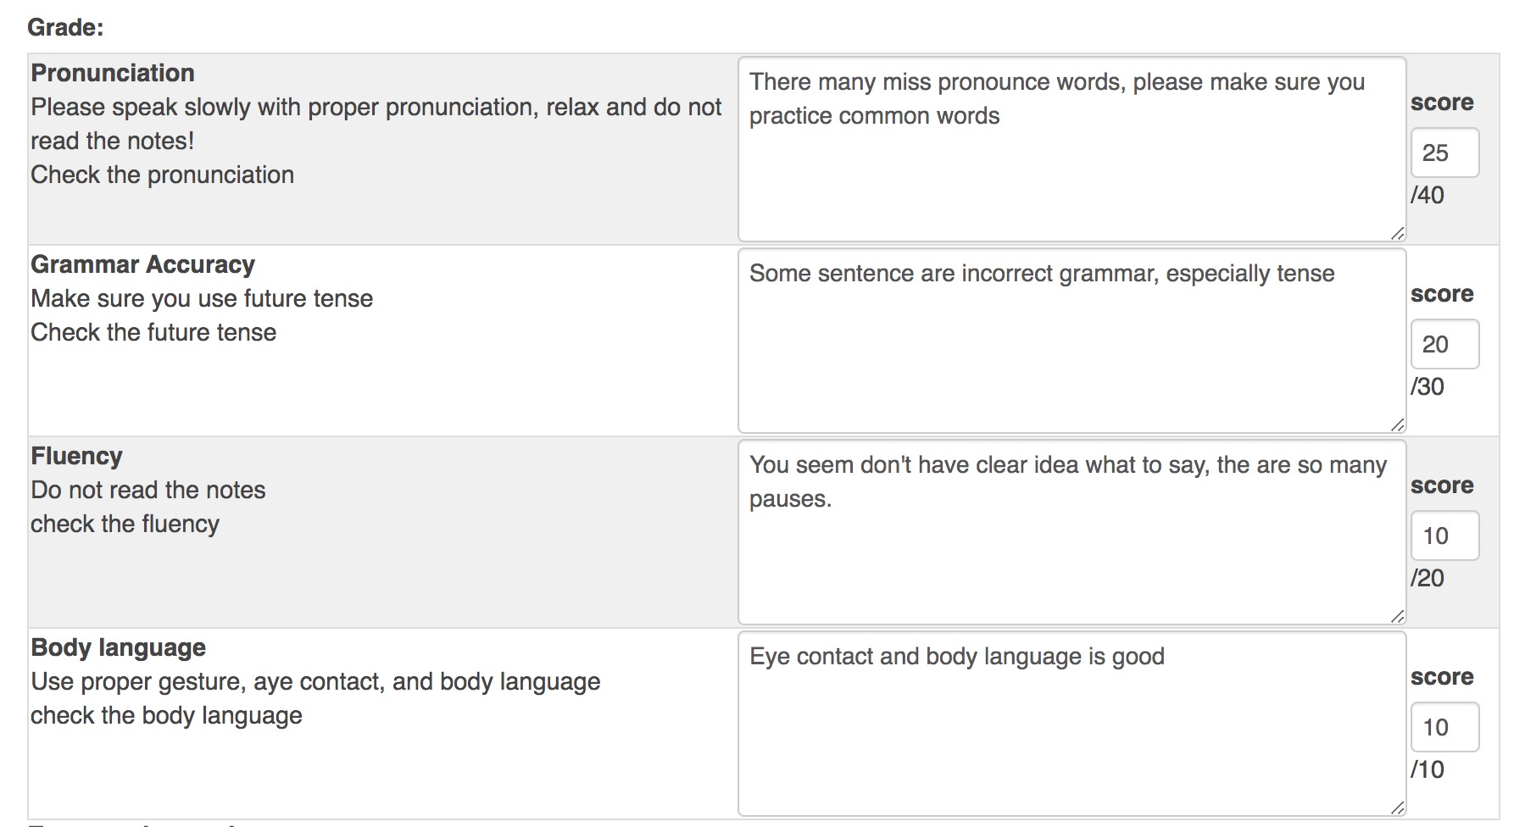
Marking Guide
Advantages
More consistent
Detail comment for feedback
Disadvantages
Time-consumed to put the grade manually

Slide 18
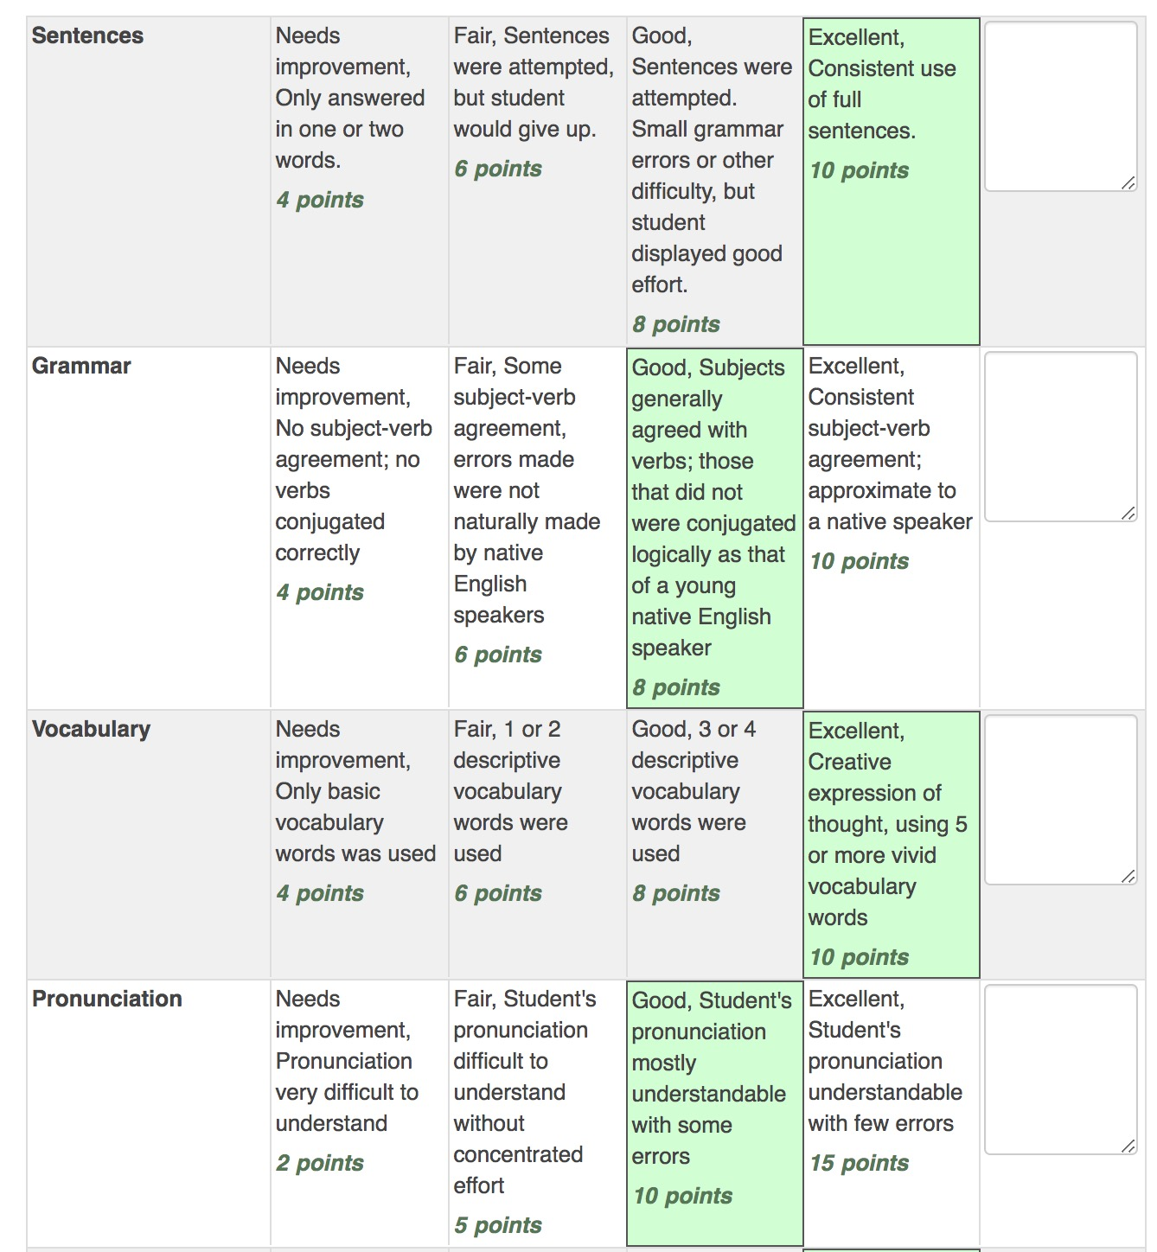
Rubric
Advantages
Detail comment, only need general feedback
Fast and consistent
Automatic calculation
Disadvantages
Need time to prepare the rubric

Slide 19
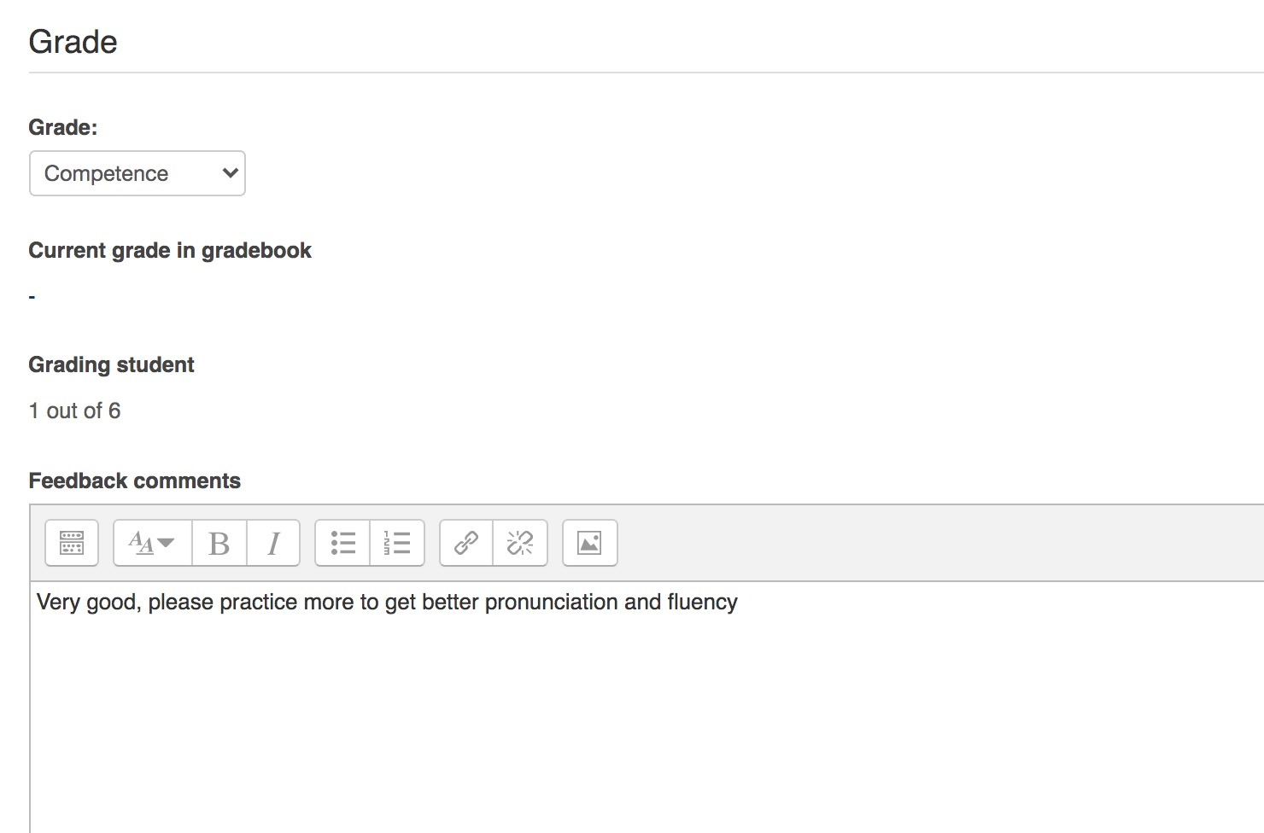
Scale
Advantages
Very simple to use
Disadvantages
Grade is to simple and not vary

Slide 20
Which one is the best?
It is not which one is the best, but which one suite to your assessment
Different grading be used for different assessment.
Example:
For formative assessment, you can use rubric and and marking guide since they both provide detail comment for each skills and it can help student to focus to improve their weakness.
For summative assessment, simple grading may help since it is simple and focus on the grade, not the comment or feedback.

Slide 21
Conclusion
Assessment is very important to measure students competence or skills.
Online assessment can be a good alternative for assessing speaking.
It is need to be well-prepared to meet the objective of the study.
No single approach/method/strategy best for all skills, each has advantages and disadvantages.
Effective assessment means using a proper approach and method for different purposes.

