Slide 1
Rangkaian Pelatihan Volunteer ASSIST
SERI I:
the Ethics of Academic Writing
&
Citations

Slide 2
I. Ethics of Academic Writing

Slide 3
Go to www.menti.com
Password: 48 99 56 3
1 orang = 2 jawaban max.

Slide 4
Ethics = Staying Away From?
Plagiarism
Scientific misconduct

Slide 5
Ethical Writing
No plagiarizing.
Acknowledge range of perspectives.
Clearly state sources.
Inclusive, respectful, acknowledge diversity, avoid stereotyping: gender, age, nationality, race, ethnicity, sexual orientation, etc.
Use inclusive language: “police officer” rather than police man.
Avoid overly emotional words, or words that cannot be proven/ measured.

Slide 6
Credibility of a Source
Who wrote it? What are the writer’s credentials?
Why was it written?
Is it relevant to your research/ writing?
Where was it published?
How long ago was it published?
From the internet? Is the website reliable and credible?

Slide 7
OBJECTIVE RESEARCH = OBJECTIVE WRITING
“Akuh pokoknya gini”
Legowo…
Berpikiran terbuka
Jangan maksa!

Slide 8
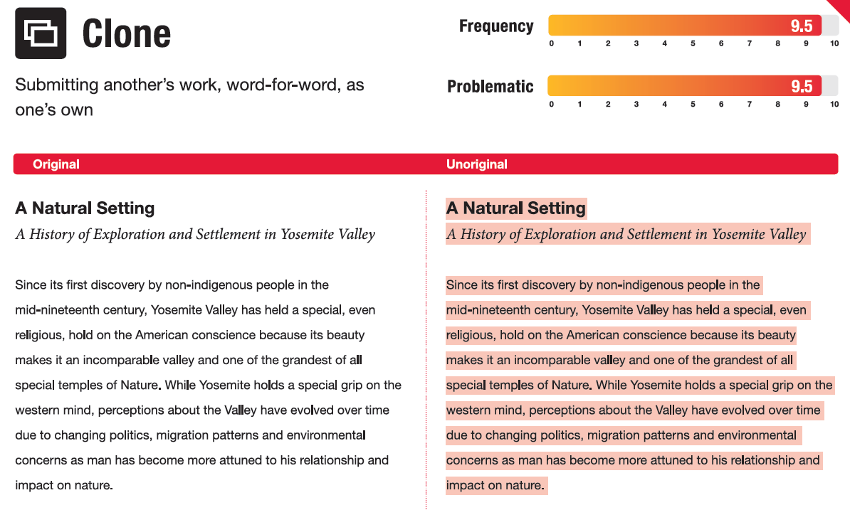
01
Objectives
You could enter a subtitle here if you need it

Slide 9
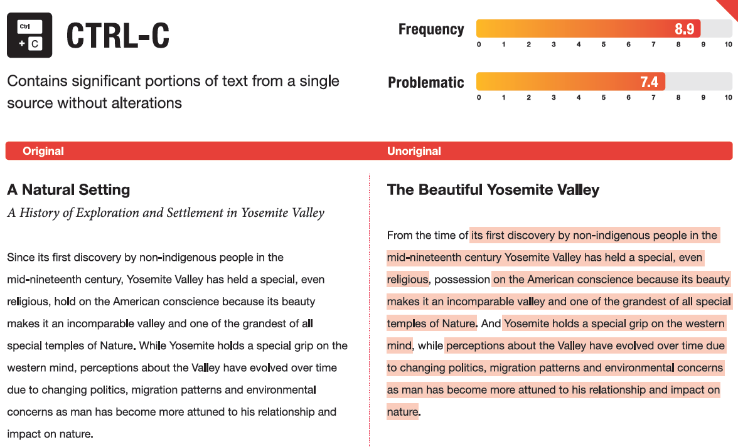
01
Objectives
You could enter a subtitle here if you need it

Slide 10
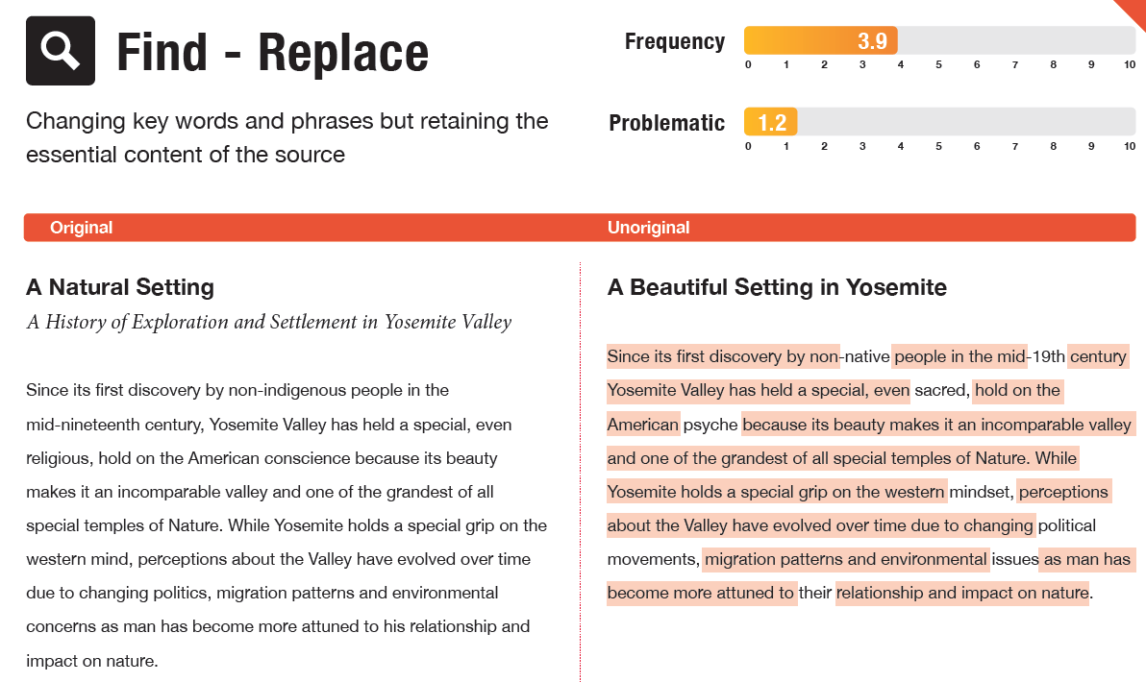
01
Objectives
You could enter a subtitle here if you need it

Slide 11
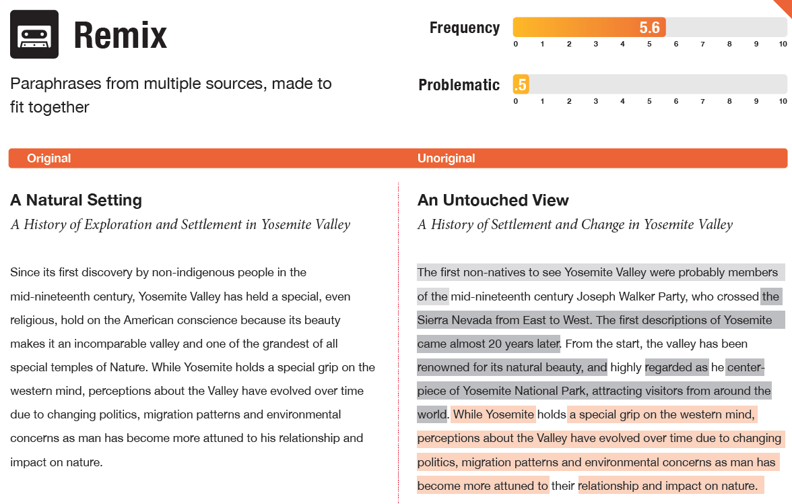
01
Objectives
You could enter a subtitle here if you need it

Slide 12
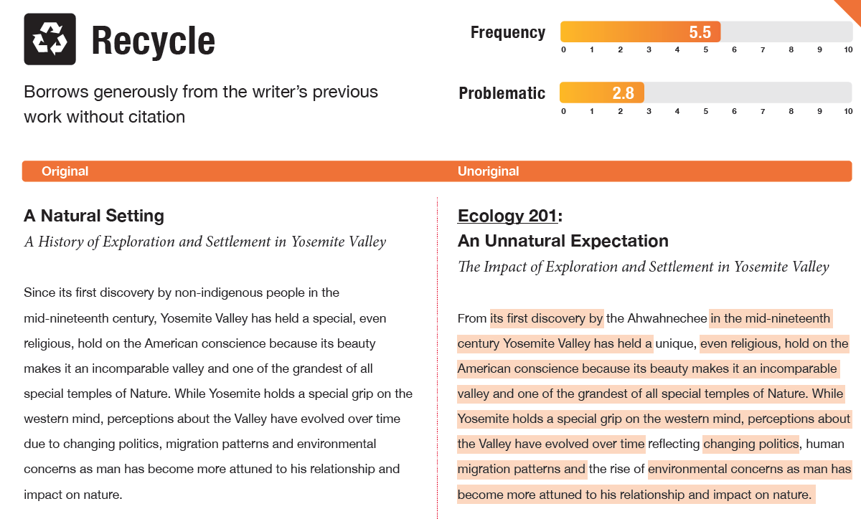
01
Objectives
You could enter a subtitle here if you need it

Slide 13
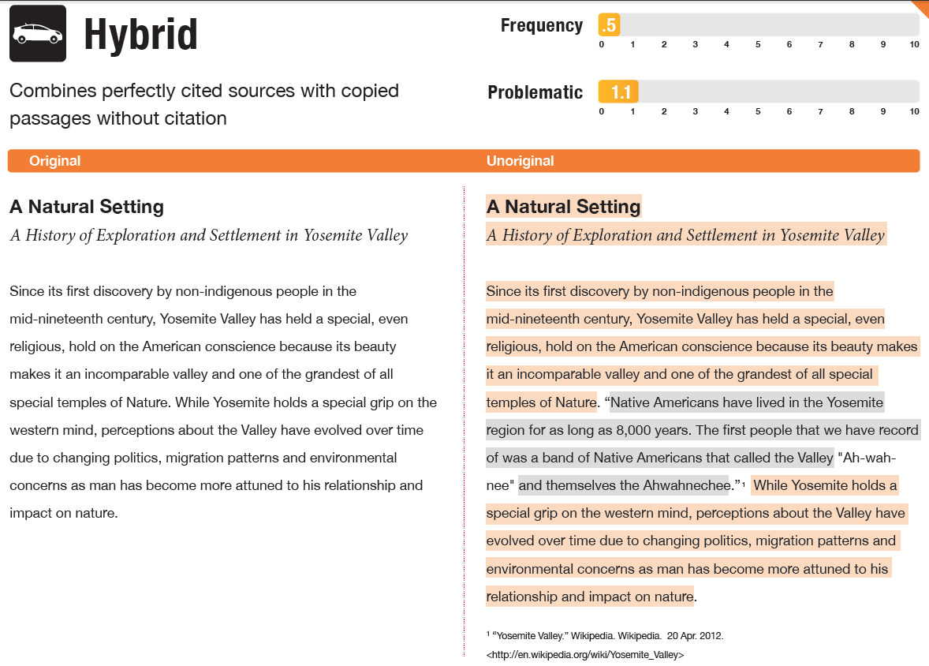
01
Objectives
You could enter a subtitle here if you need it

Slide 14
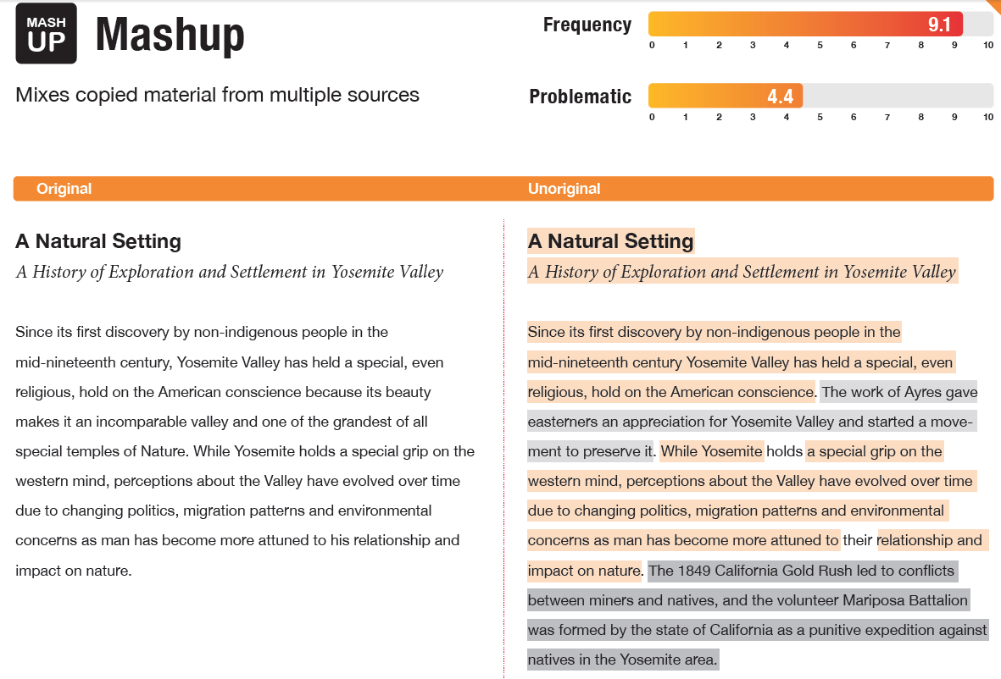
01
Objectives
You could enter a subtitle here if you need it

Slide 15
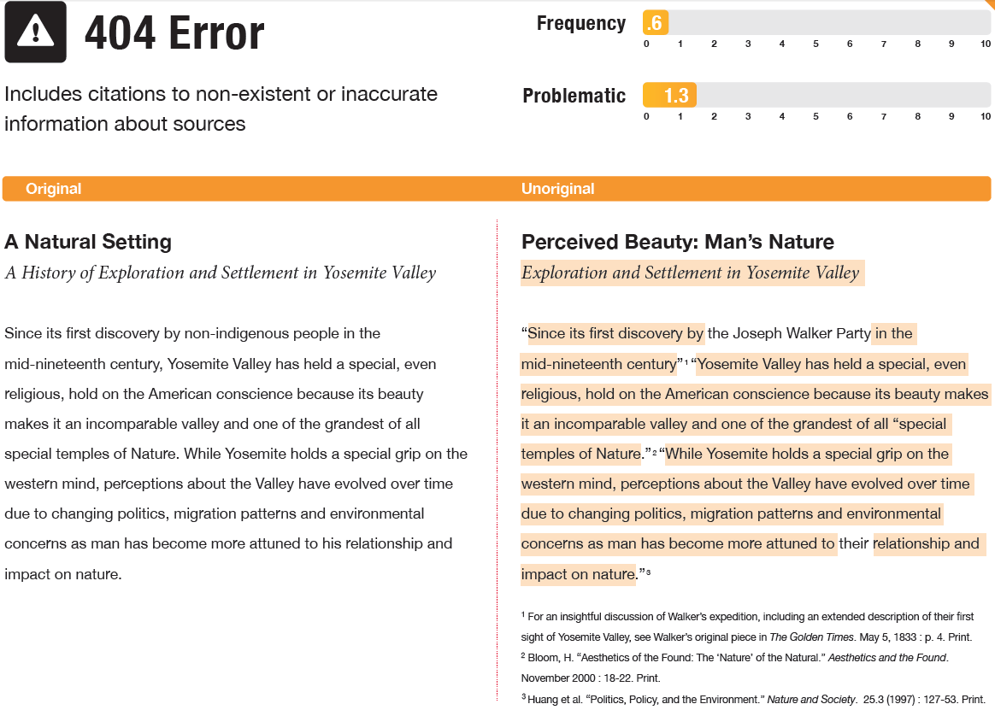
01
Objectives
You could enter a subtitle here if you need it

Slide 16
01
Objectives
You could enter a subtitle here if you need it

Slide 17
01
Objectives
You could enter a subtitle here if you need it

Slide 18
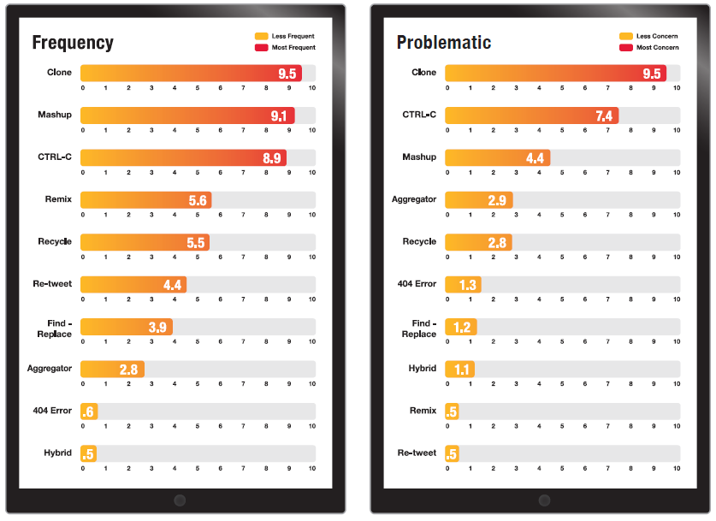
01
Objectives
You could enter a subtitle here if you need it

Slide 19
Where to provide references?
Quotation
Paraphrase
Summary
Using exact words
Picking other people’s idea but using your own words - passage.
Using main points of someone else's opinions, theories or data or use other people’s data or figures – summary of the whole text.

Slide 20
C
H
01
02
M
P
03
04
Simple paraphrasing strategy – CHoMP
Cross out small words such as prepositions and conjunctions.
Highlight important information in the remaining text.
Make notes based on the highlighted information by abbreviating, making lists, using symbols, and drawing, instead of using full sentences.
Put the notes in your words.

Slide 21
EXERCISE!!!

Slide 22
Paraphrase this passage from CNN Indonesia
Jumlah kumulatif kasus positif virus corona (Covid-19) di Indonesia per Jumat (25/9) adalah 266.845 orang. Angka tersebut bertambah 4.823 dari sehari sebelumnya. Dari jumlah kumulatif tersebut sebanyak 196.196 sembuh (bertambah 4.343) dan 10.218 meninggal (bertambah 113). Untuk diketahui, hari ini adalah rekor baru tambahan pasien positif Covid-19 di Indonesia. Rekor sebelumnya adalah pada 24 September lalu sebanyak 4.634 orang. Selain itu, hari ini adalah untuk ketujuh kalinya tambahan harian positif Covid-19 pecah rekor sepanjang September ini.
-Jakarta, CNN Indonesia, 25 September 2020
https://www.cnnindonesia.com/nasional/20200925145119-20-550983/kasus-positif-25-september-pecah-rekor-lagi-4823-orang

Slide 23
Answer in:
Go to:
www.menti.com
Password:
48 99 56 3

Slide 24
Use the CHoMP Strategy
Dozens of wildfires are tearing through California. Two of them, not far from San Francisco, are among the three largest in the state’s history. “The wildfire situation throughout California is dangerous and must be taken seriously,” Randy Moore, of the U.S. Forest Service, told the AP. In an average California fire season, about 300,000 acres burn. This year, wildfires have already destroyed more than 2 million acres. Hundreds of people had to be rescued by helicopter. At press time, fires had killed at least seven people and damaged more than 3,300 structures. Things could get worse. California is only now entering peak wildfire season. By this time of year, the summer heat has dried out plant life, and high winds are common. An intense heat wave has added to the trouble. On September 6, Los Angeles County recorded its highest temperature ever: 121°F. Parts of the Pacific Northwest are also ablaze. In Oregon, fires caused thousands to lose power. And in Eastern Washington, most of the small town of Malden was destroyed by flames.
-Shay Maunz, “Record Wildfires”, Time for Kids (Sept 18, 2020)
https://www.timeforkids.com/g56/record-wildfires-2/

Slide 25
II. Citation Styles

Slide 26
Most Common Citation Styles in Social Science
APA
Chicago Manual of Style (CMOS)
IEEE
MLA
Turabian
American Psychological Association.
Professionals and students in social and behavioural science.
Writing styles and source citations, data, presenting quantitative and qualitative data in tables and figures.
Book publishers, professionals, academics in history, art, humanities and social sciences.
Most complete: writing style, citations, editing and proofreading.
Modern Language Association.
Source citation.
Students in literature.
Same with CMOS.
Students in history, arts, humanities, social sciences.
How to research and write.

Slide 27
Overview - Referencing
 | In-text Citation | Other
APA | (Author Last Name, year) | -
CMOS | (Author Last Name, year) | Notes (using numbers) – after punctuation, except dash.
Turabian | (Author Last Name, year) | Notes (using numbers) - after punctuation, except dash.
IEEE | [1], [2] or [2]-[7] | Cinta itu buta.¹ Cinta itu buta¹ – sekali [2], [3], [4]-[6]
IEEE: list of reference will be at the end of the writing.

Slide 28
Example - Book
 | In-text Citation | Notes | Bibliography/References
APA | (Nasir, 2020) |  | Nasir, P. E. (2020). How to cite sources. Cengkeh Publications.
CMOS | (Nasir, 2020) | ¹Putiviola Elian Nasir, How to Cite Sources (Padang: Cengkeh Publications, 2020), 99 – 100. | Nasir, Putiviola Elian. How to cite sources. Padang: Cengkeh Publications, 2020.
Turabian | (Nasir, 2020) | ¹Putiviola Elian Nasir, How to Cite Sources (Padang: Cengkeh Publications, 2020), 99 – 100. | Nasir, Putiviola Elian. How to cite sources. Padang: Cengkeh Publications, 2020.
IEEE | [1], [2] or [2]-[7] | - | [1] P. E. Nasir, How to Cite. Padang, Indonesia: Cengkeh Publications, 2020.

Slide 29
Example – Online Book
 | In-text Citation | Notes | Bibliography/References
APA | (Nasir, 2020) | - | Lystra, K. (2004). Dangerous Intimacy: The Untold Story of Mark Twain's Final Years. University of California Press. http://ark.cdlib.org/ark:/13030/kt8779q6kr
CMOS | (Nasir, 2020) | ² Karen Lystra, Dangerous Intimacy: The Untold Story of Mark Twain's Final Years (Berkeley: University of California Press, 2004), 59, http://ark.cdlib.org/ark: /13030/kt8779q6kr/. | Lystra, Karen. Dangerous Intimacy: The Untold Story of Mark Twain's Final Years. Berkeley: University of California Press, 2004. http://ark.cdlib.org/ark:/13030/kt8779q6kr/.
Turabian | (Nasir, 2020) | Same. | Same
IEEE | [1], [2] or [2]-[7] | - | [1] K. Listra, Dangerous Intimacy: The Untold Story of Mark Twain's Final Years. Berkeley, USA: University of California Press, 2004. [Online]. Available: http://ark.cdlib.org/ark:/130 30/kt8779q6kr/. Accessed: September, 25, 2020.

Slide 30
Example – Government Report
 | Bibliography/Reference
APA | United States Government Accountability Office. (2019). Performance and accountability report: Fiscal year 2019. https://www.gao.gov/assets/710/702715.pdf
CMOS | United States Government Accountability Office, Performance and accountability report: Fiscal year 2019, 2019. https://www.gao.gov/assets/710/702715.pdf
Turabian | Same
IEEE | [1] United States Government Accountability Office. (2019, March. 7). Performance and accountability report: Fiscal year 2019. [Online]. Available: https://www.gao.gov/assets/710/702715.pdf

Slide 31
Example – Journal Article
 | Bibliography/Reference
APA | Scruton, R. (1996). The eclipse of listening. The New Criterion, 15(3), 5–13.
CMOS | MacDonald, Susan Peck. “The Erasure of Language.” College Composition and Communication 58, no. 4 (2007): 585-625.
Turabian | Same
IEEE | [1] K. M. Bivens and K. Cole, “The grotesque protest in social media as embodied, political rhetoric,” Journal of Communication Inquiry, vol. 42, no. 1, pp. 5-25, Jan. 2018, doi: 10.1177/0196859917735650.

Slide 32
Example – Webpage or Piece of Online Content
 | Bibliography/Reference
APA | Price, D. (2018, March 23). Laziness does not exist. Daily Motivations. https://humanparts.medium.com/laziness-does-not-exist-3af27e312d01
CMOS | Heck, Richard Kimberly. “About the Philosophical Gourmet Report.” Food around Us. Last modified August 5, 2016. http://rgheck.frege.org/philosophy/aboutpgr.php.
Turabian | Same
IEEE | [1] G. Dvorsky. “NASA is officially sending an aerial drone to Titan and it's a dream come true.” Gizmodo. https://gizmodo.com/nasa-is-officially-sending-an-aerial-drone-to-titan-and-1835918159 (accessed July 3, 2019).

Slide 33
Quotation
Use “…”
Shorter than 40 words – in the paragraph.
More than 40 words – have its own paragraph = block quotations.
In text citations should add page: (Nasir, 2020: 10), [1, p. 10]

Slide 34
Useful Sources
In gdrive
Websites:
https://owl.purdue.edu/owl/research_and_citation/ieee_style/in-text_citation.htmlAUTHOR (YEAR). Title of the publication. Publisher
https://cmosshoptalk.com/2019/02/12/how-do-i-format-a-figure-and-caption-in-turabian-chicago-style/AUTHOR (YEAR). Title of the publication. Publisher
https://pitt.libguides.com/citationhelp/apa7

Slide 35
EXERCISE!
Write down bibliographies/citation Practice Sheet 2 in gdrive

Slide 36
TOOLS
Mendeley & Word

Slide 37
Thanks!
Please keep this slide for attribution.

