Slide 1
Paddy Farmers’ Perception and Their Adaptation to Climate Change :
Case Study at Singkarak Lake Cathment Area of West Sumatra, Indonesia
Refdinal, Rudi Febriamansyah, Endry Martius, and Mahdi
UNIVERSITAS ANDALAS, PADANG. INDONESIA

Slide 2
Introduction
Climate change is currently becoming big global issue.
The change impacts hugely to local people livelihood.
The most terrible impact is to agriculture, especially to on-farm activities.
As located in tropical region, Indonesia is the most vulnerable country in facing the climate changes.
We observed the climate changes at local level, trough meteorological data, on Singkarak catchment area.
Then, we study the paddy farmers perception on the changes and the impacts to their farming and how do the farmers adapt to the changes.

Slide 3
Research Method
Location : Singkarak cathment area which cover 13 nagaris (Villages).
We carried out paddy farming’s household to interview 130 farmers, who randomly sampled, 10 sampled farmers for each nagari.
Data :
  Farmers perception
  Impact climate changes to paddy farming
  Farmers adaptation to the changes
Data analysis : qualitative.

Slide 4
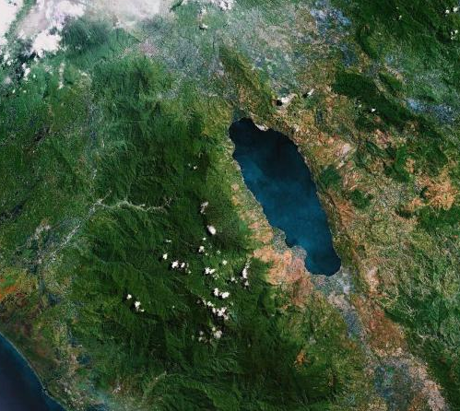
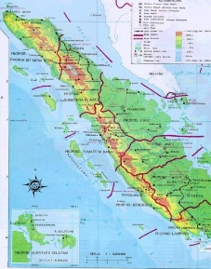
The Study Site :
N. Simawang
N. Paninggahan
N. Singkarak
N. Sumani
N. Saningbaka

Slide 5
RESULTS

Slide 6
Farmers’ Perception on Climate Changes
No | Farmer’s Perception on climate change | Number Respondents | Percenatege (%)
1 | Yes | 129 | 99
2 | No | 1 | 1
 | Total | 130 | 100

Slide 7
Farmers’ perception of the beginning of climate change
No | Climate change start | Numbers of farmers | %
1 | < 10 years | 109 | 84
2 | 10 – 20 years | 16 | 12
3 | >20 years | 4 | 3
 | Total (n) | 129 | 100

Slide 8
Farmer’s Perceptions on indicators CC
No. | Indicator / form of climate change | Number Respondents | %
1 | Uncertainty of dry and wet season time | 95 | 74
2 | Longer dry and shorter rainy season | 68 | 53
3 | Higher temperature | 33 | 26
4 | Stronger wind, fog | 9 | 7
 | number of answers | 205*)
 | numbur of farmers | 129
*) Answer of farmer more than 1
**) Persentage of farmers

Slide 9
Effects of climate change on farming
No | Effects on farming | Number Respondents | %
1 | Drought / flood | 90 | 70
2 | Disorders of plants | 71 | 55
3 | Disease of disease pests | 35 | 27
4 | Disruptin of planting schedules | 13 | 10
5 | Decline in production | 129 | 100
 | Number of answers | 338*)
 | Number of farmers | 129
*) Answer of farmer more than 1
**) Persentage of farmers

Slide 10
Adaptation Which have Been Taken by farmers
No | Farmer adaptation | Number of farmers (person) | Persentage**) (%)
1 | Given untill enough water | 73 | 57
2 | Planted according to water conditions | 63 | 49
3 | Change cropping pattens | 13 | 10
4 | Plant adaptive varieties | 7 | 5
5 | Using organic fertilizer | 8 | 6
6 | Conduct irrigation management | 79 | 61
7 | Diversify plants | 17 | 13
8 | Climate field school | 4 | 4
9 | SLPHT | 6 | 5
10 | Intensify group activities | 34 | 26
11 | Conduct land rehabilitation | 13 | 10
12 | Access funding | 3 | 2
13 | Make borehole / pump | 7 | 5
14 | Intensify fire group | 5 | 4
15 | Reforestation | 6 | 5
16 | Planting schedule | 53 | 41
17 | Encouraged to migrate | 3 | 2
18 | Try outside farming | 41 | 32
19 | Make a resrvoa | 5 | 4
20 | Intensify dry land | 58 | 45
21 | Agrucultural insurance | 2 | 1
 | Number of answers | 500*)
 | Number of farmers | 129

Slide 11
Farmers assessment of adaptation efforts undertaken
No | Efforts to provide maksimum risult | Number Respondents | %
1 | Yes | 30 | 23
2 | No/not yet | 99 | 77
 | Amount | 129 | 100

Slide 12
Farmers’ Crying for Help on:
No | Farmers Needs | Number of Respondents | Persentage**) (%)
1 | Fix irrigation / springs (looking for water, managing water) | 74 | 57
2 | Procurement of pumps | 13 | 10
3 | Make a reservoir | 5 | 4
4 | Information about plant maintenance | 3 | 2
5 | Pest and deases control | 10 | 8
6 | Community training | 2 | 2
7 | Accsess funding / aid | 6 | 5
8 | Intensify gropus | 1 | 1
9 | Assistance for the inputs | 12 | 9
10 | Look for climate change resistant varities | 4 | 3
11 | Climate information for farmers | 4 | 3
12 | Adaptive cultivation information | 1 | 1
13 | Government policieas related to the economy (new business) | 5 | 4
14 | cement assitance | 2 | 2
 | Number of answers | 142*)
 | Number of farmers | 129

Slide 13
CONCLUSION AND POLICY IMPLICATION

Slide 14
Conclusion
Farmers felt that the climate has being changes:
    Uncertainty of rainy and the dry season time
    Longer dry and shorter rainy season
    Higher temperature
    Stronger wind, fog
Those climate change has resulted in disruption of water availability, disruption of the production process and then finally the decreased in rice production, the majority of which is 25-50% decreased and some have failed completely.
Farmers have made various adaptation efforts, are: (1) letting the land uncultivated until sufficient water is available, (2) applying rice farming with limited water availabity, (3) improving their irrigation management, (4) intensifying group activities, (5) arranging planting schedules, (6) doing business outside of farming, and (7 ) intensify the dry land they have. However, farmers are still thinking that their efforts are not maximized yet.

Slide 15
Policy Implication
Related parties such as the agricultural service, extension institutions, irrigation an public work agencies, BMKG, and universities needs to pay attention and maximize the adaptation efforts that have been made by farmers
Need to conductt further research to find empirical findings academically, so that the policies are more appropriate.

Slide 16
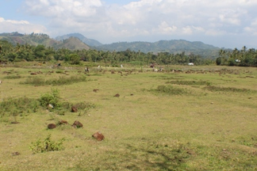
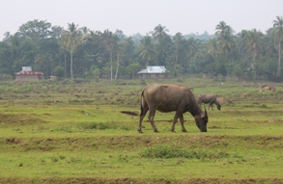
SOME PICTURES FROM THE FIELDS

Slide 17
THANK YOU

