Slide 1
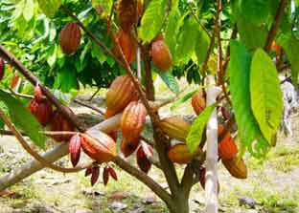
Technical Efficiency Analysis of Smallholder Cacao Farmers in West Sumatra
Hasnah and Ifdal
APDP Conference “Research for Impact”
23 – 24 January 2018 in Jakarta

Slide 2
Outline
Background
Objectives
Methodology
Results and discussion
Implication

Slide 3
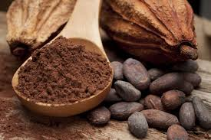
Background
Indonesia the 3rd largest cacao producer in the world (area 1.7 million ha and production 0.7 million tonne)
Source of income for > 1.7 million farmers
Contributes to export earning (the fourth among agricultural commodities)

Slide 4
Cacao Area and Production in Top 5 Provinces
Share of 5 provinces: 65% of total area and 72% of total production

Slide 5
The Growth of Cacao area and Production in West Sumatra

Slide 6
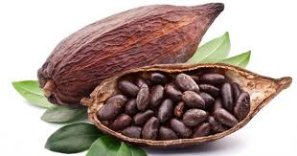
Cacao Area in West Sumatra by Farming Category
Cacao area (ha)
Productivity (ton /ha)

Slide 7
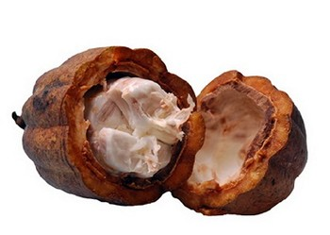
Facts
Smallholder not efficient?
Low productivity: smallholders
Low Income

Slide 8
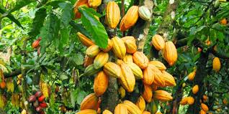
Farming system
Smallholder: multiple cropping
Private company: mono cropping

Slide 9
Objectives
analyze the technical efficiency of smallholders producing cacao beans in West Sumatra
Identify factors influencing the technical efficiency of cacao farming.
Identify crops that are suitable to cultivate in multiple cropping system with cacao trees.

Slide 10
Methodology
Study site:
3 municipalities: 50 Kota, Pasaman and
Padang Pariaman
Selection of sample: simple random sampling
300 farmers were interviewed using a questionnaire based on recall
Data analysis: stochastic frontier production function

Slide 11
Results and discussion

Slide 12
Farmers’ profile
Description | Total (n = 287) | Percentage
Gender
Male | 213 | 74.22
Female | 74 | 25.78
Age
< 40 years | 72 | 25.09
40 – 60 years | 175 | 60.98
> 61years | 40 | 13.94
Education
No education | 42 | 14.63
Primary school | 105 | 36.59
Junior high school | 58 | 20.21
Senior high school | 70 | 24.39
University | 12 | 4.18

Slide 13
Farming profile
Description | Total (n = 287) | Percentage
Land size
< 1 ha | 162 | 56.45
1 - 2 ha | 112 | 39.02
> 2 ha | 13 | 4.53
Age of cacao trees
< 10 years | 131 | 45.64
10 - 15 years | 116 | 40.42
> 15 years | 40 | 13.94

Slide 14
Intercropping
Description | Total (n = 287) | Percentage
Durian | 75 | 26.13
Rubber | 51 | 17.77
Coconut | 119 | 41.46
Candle nut | 2 | 0.70
Monocropping | 4 | 1.39
Areca nut | 7 | 2.44
Banana | 29 | 10.10

Slide 15
Production and Input Used per Ha
Description | Total
Number of trees | 674.00
Production (kg) | 496.90
Manure (kg) | 1,093.55
Urea (kg) | 83.10
NPK (kg) | 60.02
Pesticide (litre) | 1.87
Herbicide (litre) | 3.50
Labour (mandays) | 110.72

Slide 16
Problem at farm
Squirrel attack
Helopeltis

Slide 17
Maximum Likelihood Estimate of Cobb Douglas Production Function
Variable | Coefficient | z-value
Constant | 6.58* | 36.16
ln (manure) | 0.07* | 4.47
ln (Urea) | -0.10* | -4.21
ln (NPK) | 0.05* | 2.26
ln (Pesticide) | -0.36* | -5.05
ln (Herbicide) | 0.09** | 1.69

Slide 18
Technical Efficiency Level
Average : 0.5
Range: 0.1 – 0.83

Slide 19
Distribution of Technical Efficiency Level

Slide 20
Maximum Likelihood Estimate of Inefficiency Model
Variable | Coefficient | z-value
Durian | -1.48* | -2.32
Candle nut | 0.21 | 0.28
Coconut | 0.98* | 2.76
Banana | -0.38 | -0.76
Areca nut | -2.98 | -0.89
Land size | 0.42* | 2.31
Land status | 0.62 | 1.00

Slide 21
Implication
Need more study on agronomic field on cacao-durian and cacao-coconut intercropping
Need pest management and fertilizing practices training

Slide 22
Thank you

